Slide 1
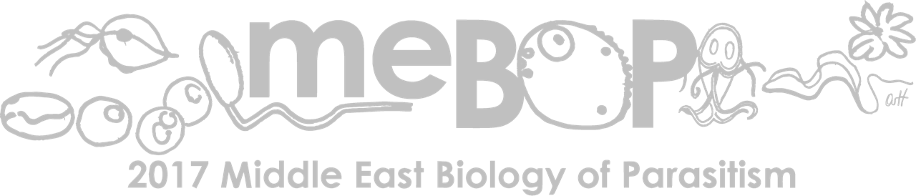
Doaa Nassar Assistant lecturer of medical parasitology Faculty of medicine Ain shams university Cairo- Egypt

Slide 2
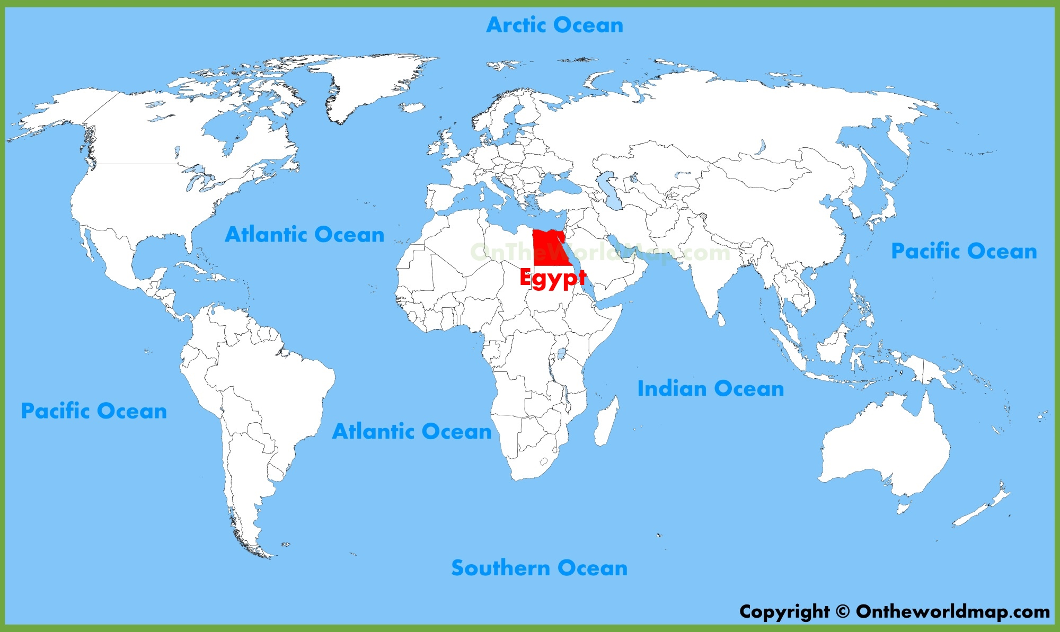
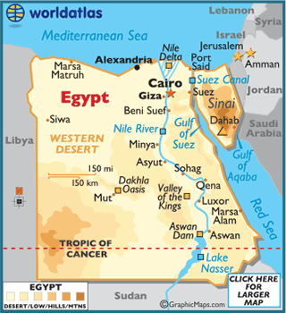

Slide 3
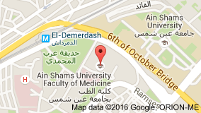
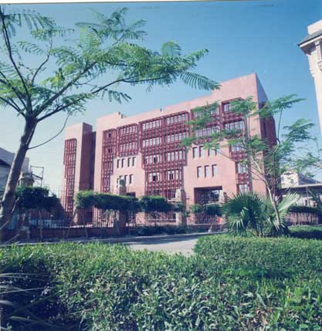

Slide 4


I graduated in med school on December, 2010. And I have been working since 2012 as a demonstrator then as an assistant lecturer in the medical parasitology department.
I worked for 5 years at the parasitology research and diagnostic laboratory unit for diagnosis of parasitic diseases, and gained experience in examination of urine, stool and blood samples for detection of parasites and serological testing of serum samples.

Slide 5
The parasitology researches in my department are directed towards:
- Studying the disease prevalence and epidemiology.
- New diagnostic methods
- New lines of treatment
-Prevention and control of parasites of medical importance
-Recently, they are directed towards molecular diagnosis and genotyping.
Notes:
3) what is the main research questions in the lab or division you work in.

Slide 6
I earned my master degree in medical parasitology in 2015 with a thesis entitled "Evaluation of The Effect of Iron and Polyamines on Trichomonas Vaginalis Virulence".
My work included the diagnosis and maintenance of T. vaginalis in modified TYM medium and to investigate the in vitro effect of iron and spermine on the growth of T. vaginalis isolates and its abilities to cytoadhere and exert its cytotoxicity to cultured epithelial cells.
Additionally, examinig the in vitro effect of iron on minimal lethal concentration of metronidazole for T. vaginalis isolates.
Notes:
4) what is the main research question of your project (be it at any level, from cloning a gene, identifying how drug resistance spread to epidemiology)

Slide 7
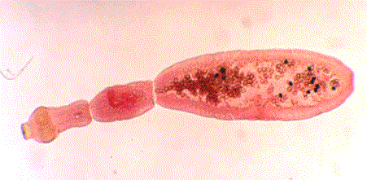
I registered for my M.D. with thesis entitled "Study of Genetic diversity of human and animals isolates of Echinococcus granulosus from Egypt" and started to collect samples, that is why I think that I am at a stage in my career, where I will benefit the most from such an
amazing course, as I have limited experience
in the field of molecular parasitology,
which is a very promising branch.

Slide 8
The aim of the study is to:
Further characterize human and animal Egyptian isolates of E. granulosus using multilocus sequence typing targeting mitochondrial genes.
Evaluate the discriminative power of the microsatellite markers to understand the molecular epidemiology of this parasite in Egypt.
Determine the phylogenetic relationship of the Egyptian isolates to reference and other strains.

Slide 9
Regarding my future:
Due to my previous work, I’m interested in the diagnosis of parasites and working with cell culture.
I’m also interested in learning new techniques for diagnosis especially the molecular techniques and the whole molecular parasitology research work and I am looking forward to improving my knowledge in this field.
I hope I can Transfer the state of the art of genotyping and phylogenetics to my colleagues in the department.

Slide 10
Work experience
I have a good experience in detecting parasites and also in the maintenance of T. vaginalis in modified diamond medium (TYM).
Also, I have a good experience in performing some tests to evaluate the effect of iron and spermine on T. vaginalis as regards its growth, its cytoadherence abilities and its cytotoxicity to cultured epithelial cells.
Notes:
5) what is one of your unique skills or expertise that someone else might benefit from (e.g. programming, medical qualification etc) and/or is there a specific resource you have access to (e.g. patient data or samples, omics core-facility, advanced microscopy etc)

Slide 11
Through our diagnostic research unit:
We have access to patients’ samples including urine, stool and blood samples.
We have access to patients’ data through direct contact with the patients.

Slide 12
Challenges I am facing while doing research in my work place:
Most of the researches depend on the researcher’s resources due to the limited fund.
Shortage in well equipped research centers and difficulty in collaboration with other private or governmental units.
The difficulty to maintain any parasite in the lab, due to:
The high cost of the maintenance culture techniques.
The difficulty to have access to liquid nitrogen system to preserve the parasite.
Notes:
7) what difficulties do you face in doing research in your local area?

Slide 13
As a developing country, the number of the staff who are experienced in molecular techniques is limited.
Difficulty in publishing internationally due to limited fund.

Slide 14
